Slide 1
Stock Prediction
By Adric Sutton

Slide 2
Objective
Predict if the stock market will go up or down the next day through supervised learning.

Slide 3
Data
The dataset used has full historical daily price and volume data for all US stocks and ETFs.
Originally it came with the columns of Date, Open, High, Low, Close, Volume, and OpenInt.
Through feature engineering I added Moving Average(10 and 50 day), Volatility, and CrossUpCrossDown
The original dataset can be found at https://www.kaggle.com/borismarjanovic/price-volume-data-for-all-us-stocks-etfs

Slide 4
Process
After creating the data frame the data was split into X_test, X_train, y_test, y_train
I then tuned the parameters of the models using GridSearch
Next the models were trained with X_train, y_train
Finally the results are shown in output with a couple of graphs

Slide 5
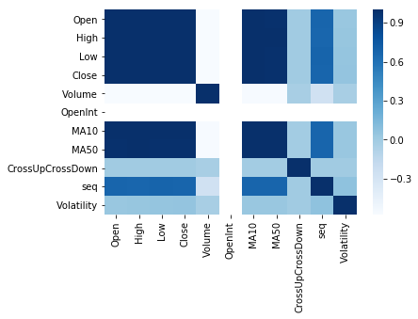
Feature Correlation

Slide 6
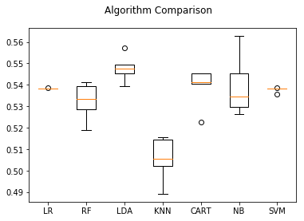
Model Comparison

Slide 7
Models and Results
The models below were trained and tested for accuracy using the training data with the Gridsearch tuning.
LogisticRegression() Accuracy = 53.8%
RandomForestClassifier() Accuracy = 53.6%
LinearDiscriminantAnalysis() Accuracy = 54.8%
SVC() Accuracy = 53.8%
KNeighborsClassifier() Accuracy = 50.5%
DecisionTreeClassifier() Accuracy = 54.2%
GaussianNB() Accuracy = 54%

Slide 8
Keras
I also made a Sequential model with Keras using two relu dense layers, a dropout , and one sigmoid dense layer.
The Accuracy is 52.9%

Slide 9
Recursive Feature Elimination
The two highest scores were Linear Discriminant Analysis and Decision Tree Classifier
RFE on LDA removed the Volume column increasing accuracy slightly
RFE on CART removed Open, High, Close, MA50, Volatility, and CrossUpCrossDown increasing accuracy slightly

Slide 10
Final Results
After taking into account the proportion of 1’s vs 0’s in the y_test set I found that 1’s showed up 52.9% of the time. So guessing 1’s would be advantageous(probably what the neural network did)
I then fit the two models with X_test set and predicted, then compared with the actual y_test.
The final scores were:
LDA 53.1%
CART 52.3%

Slide 11
Conclusion
Prediction using the basic models wasn’t very useful.
However, I did learn a lot about:
Importing and Cleaning Data
Feature Selection, Engineering and, Elimination
Common Models and Parameter Tuning
Basic Neural Networks
Sample Bias (number of 1’s vs 0’s)
Prediction within sample vs outside

